Slide 1

Forecasting Electric Vehicle Adoption and Charging Infrastructure Demand
By
Aruna Jithesh Chinmayi Karumuri
Dilip Kumar Kasina
Meghna Doddapuneni
Shanmukha Raj
Vaishnavi Samboji

Slide 2
Problem Understanding
Primary Challenge: Reducing Transportation Emissions
Climate Change Context: Climate change poses serious environmental, economic, and social challenges. Governments and businesses are focusing on reducing emissions.
Transportation Sector Impact: Transportation is the largest U.S. source of greenhouse gases, making up 28% of total emissions (U.S. EPA).
Need for EV Charging Infrastructure
EV Demand Surge: Rising EV adoption drives demand for charging stations across the U.S.
Key Challenge: The U.S. requires a well-placed, scalable charging network to efficiently meet future EV demand.
Boosting EV Confidence: An extensive charging network will help ease range anxiety, encouraging wider EV adoption
Notes:
Our project addresses the critical challenge of reducing transportation emissions. The transportation sector is the largest contributor to greenhouse gas emissions in the U.S., accounting for 28% of the total emissions, as reported by the EPA. As EV adoption grows, there’s an urgent need for scalable and efficient EV charging infrastructure to meet demand and reduce range anxiety among EV users

Slide 3
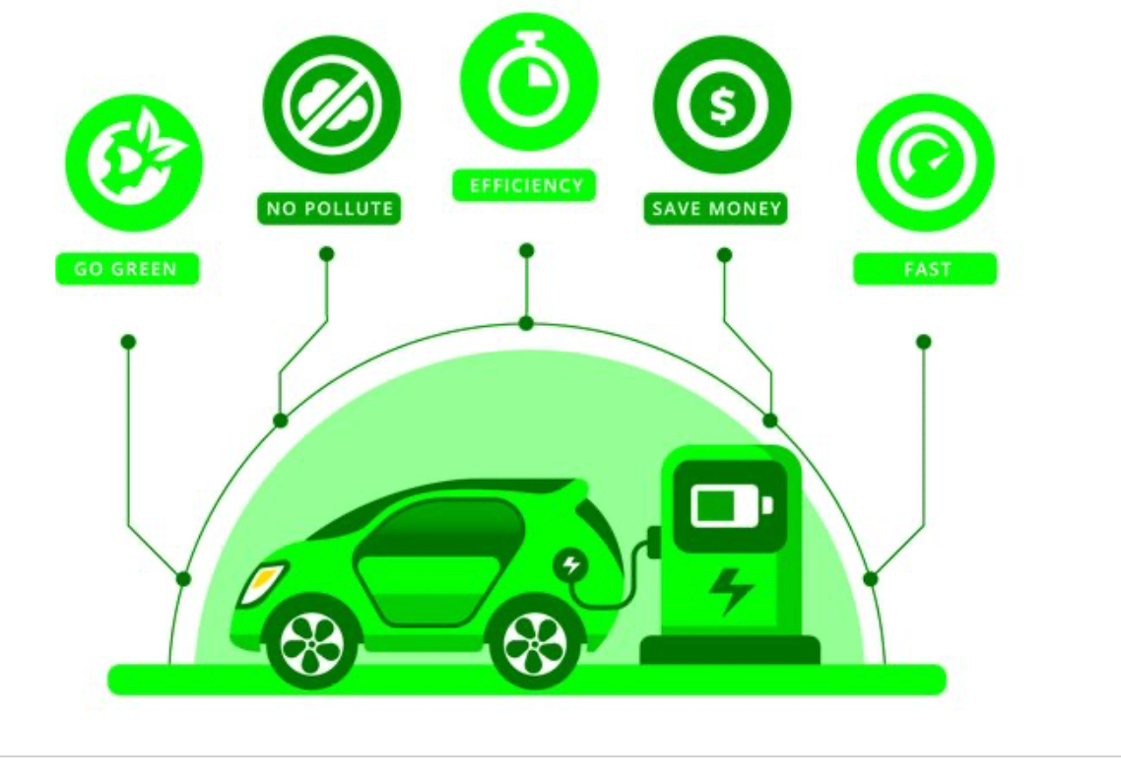
Motivation
Federal Investments: The Biden-Harris Administration is expanding EV infrastructure with a $521 million grant for 9,200 charging ports across 29 states, doubling U.S. public chargers to over 192,000 under the Bipartisan Infrastructure Law.
State-Level Commitments: Washington State awarded $85 million in 2024 to build 5,000 EV chargers, focusing on equitable access for underserved communities.
NEVI Program in Washington: Washington will receive $71 million over five years to establish fast-charging stations along major highways.
Automaker Commitments: Ford, GM, and Nissan are shifting to full EV production within the next decade, transforming transportation.
Notes:
Governments and automakers are committed to tackling climate change by expanding EV infrastructure. The Biden-Harris administration has invested $521 million to install over 9,200 charging ports across the U.S., while states like Washington are leading with $85 million allocated for equitable EV charger deployment. Automakers like Ford, GM, and Nissan are also transitioning to full EV production, making this an opportune time to analyze and plan for infrastructure growth.

Slide 4
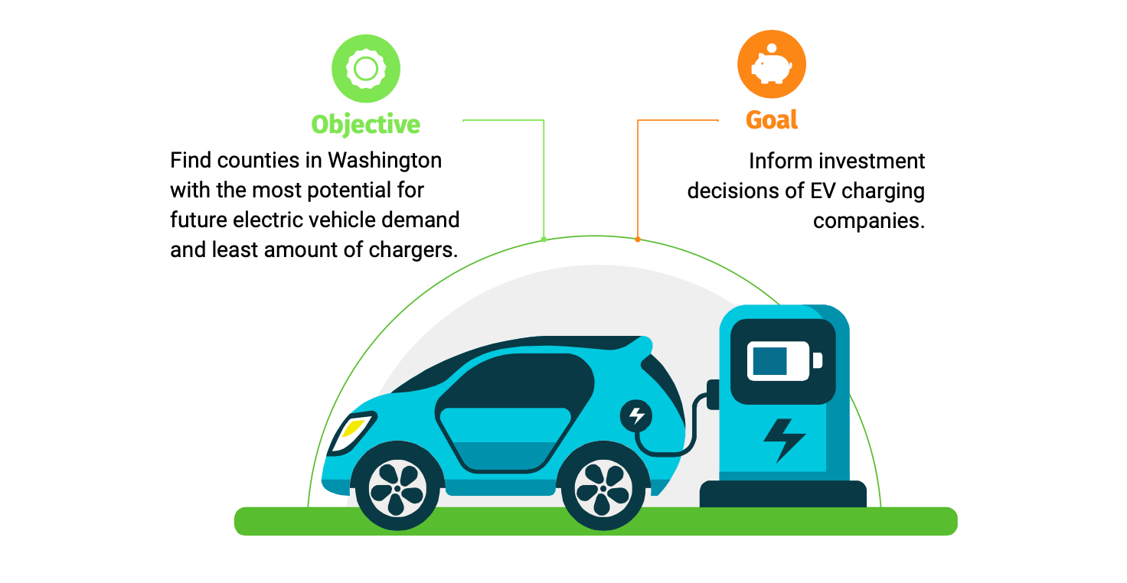
Business Goal
Notes:
The goal of our project is twofold: First, to analyze electric vehicle adoption trends using Washington State's title and registration data. Second, to assess the adequacy of current charging station infrastructure to support future EV growth. This analysis will inform strategic investments and planning for a more sustainable EV ecosystem.

Slide 5
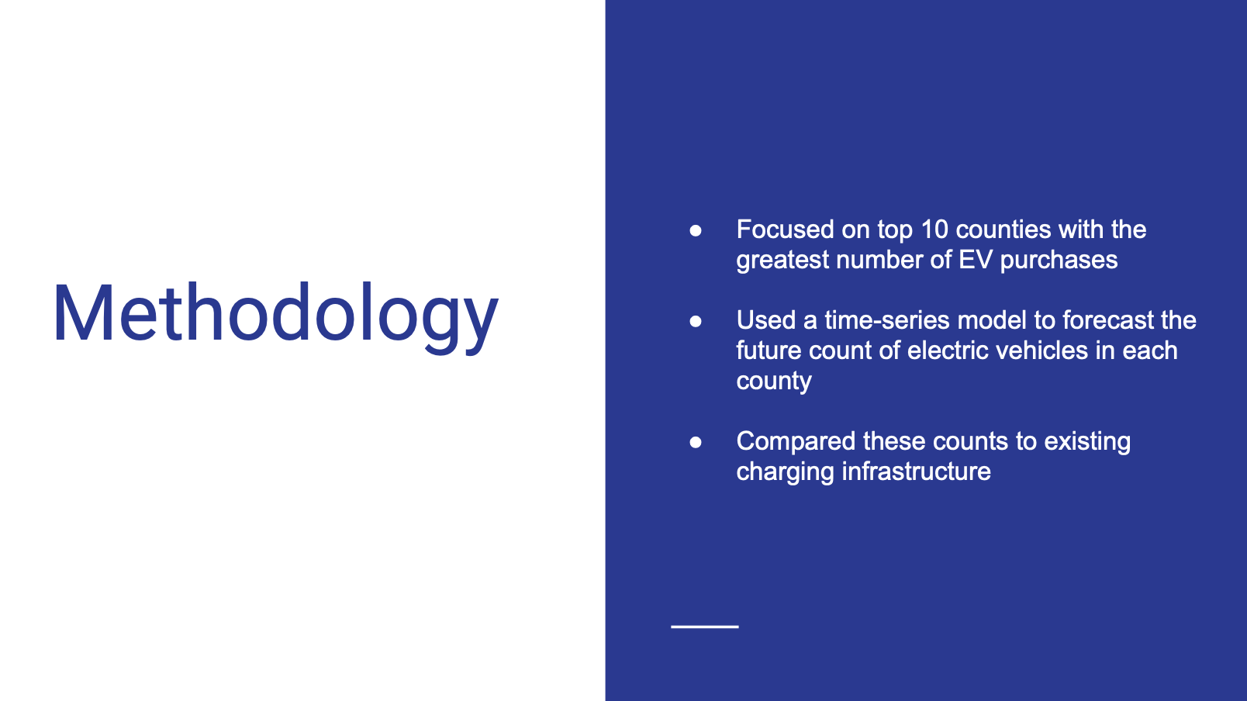
Notes:
Our methodology involved several key steps to address our objectives effectively. First, we collected data from two primary sources: electric vehicle title and registration data from Washington State and charging station data from the National Renewable Energy Laboratory API. This data spanned 2010 to 2024 and included over 1 million records with 33 attributes.
Next, we performed data cleaning and preprocessing to ensure the quality of our dataset, such as converting transaction dates to a datetime format and removing duplicates. Following this, we conducted exploratory data analysis to identify patterns and trends in EV adoption and charger distribution.
For forecasting, we implemented time-series modeling using ARIMA and SARIMAX. These models helped us capture both seasonal and non-seasonal patterns in EV demand. Finally, we evaluated model performance and validated our predictions against test data, providing actionable insights for future planning.

Slide 6
Data Source
Electric Vehicle Title and Registration Data
Source: Data.gov (Washington State)
Time Period: 2010 to 2024
Total Records: 1,048,576 title and registration transactions
Features: 33 attributes related to electric vehicle registrations
Purpose:Track electric vehicle registrations over time to identify adoption trends by year and region
Charging Station Data
Source: National Renewable Energy Laboratory (NREL) API
Active Charging Stations: 2,759 stations in Washington State as of 2024
Purpose:
Assess the adequacy of charging infrastructure relative to the growth in EV registrations.
Notes:
"Our primary datasets include EV registration data from Washington State, spanning 2010 to 2024, with over 1 million records and 33 features. Additionally, we utilized the National Renewable Energy Laboratory (NREL) API, which provides information on 2,759 active charging stations in Washington as of 2024. Together, these datasets allowed us to analyze EV adoption and infrastructure needs comprehensively.

Slide 7
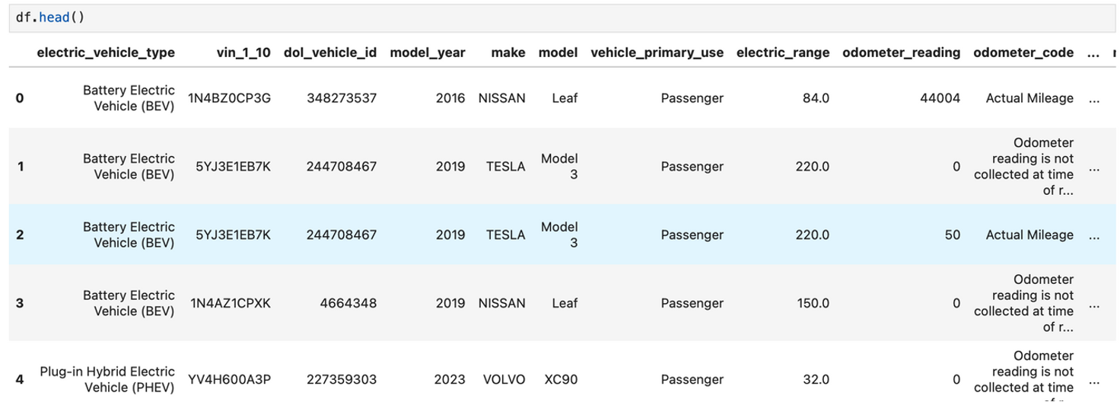
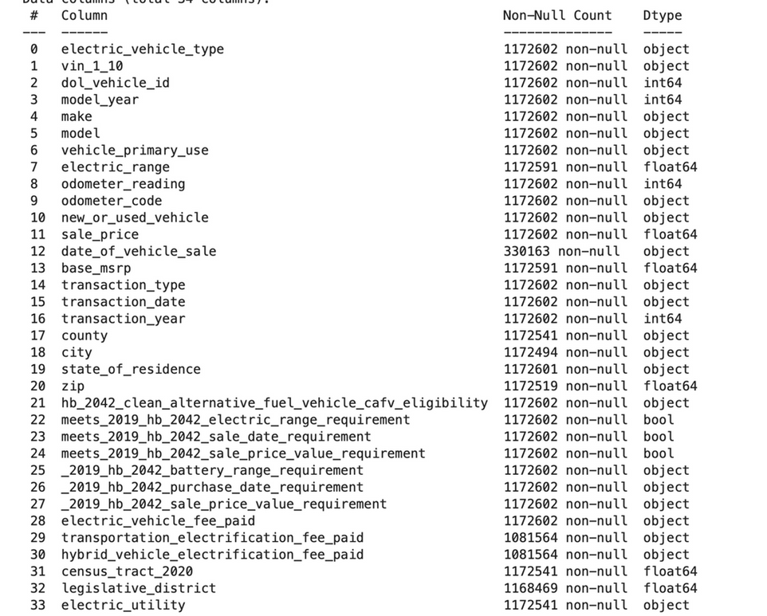

Slide 8
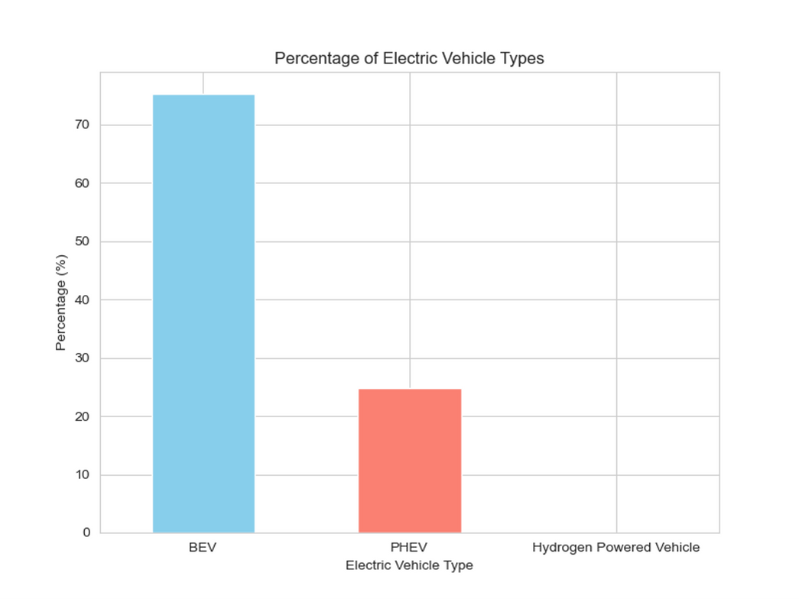
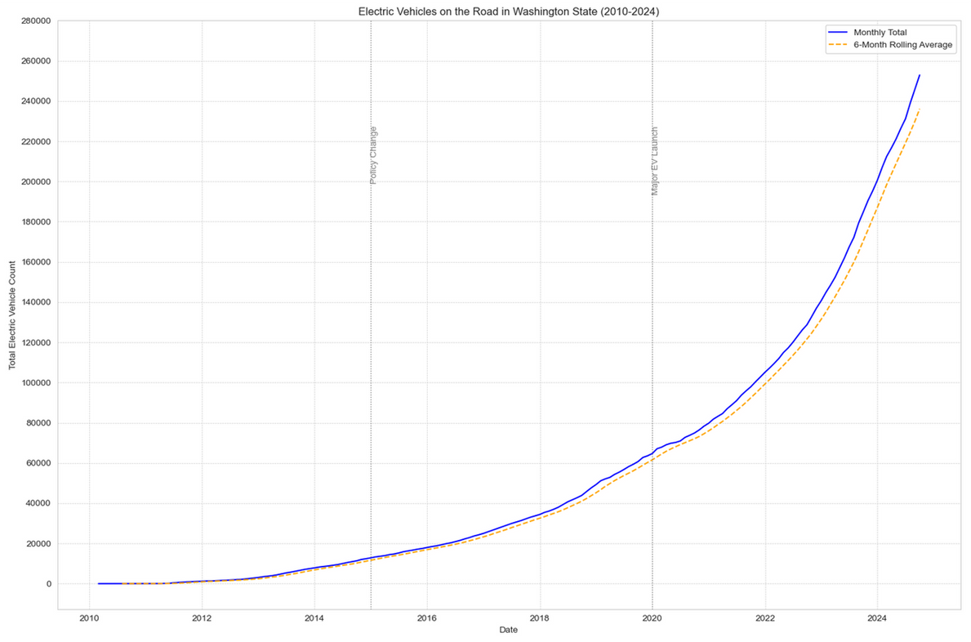
Data Exploration
EV growth in Washington State has followed an exponential trend from 2010 to 2024, with strong demand signaling robust investment opportunities in EV infrastructure.
A 6-month rolling average confirms consistent demand growth, supporting a stable market for EV charging companies.
Battery Electric Vehicles (BEV) (75% of data): Fully electric, powered by batteries, and require charging from an electric source.
Plug-in Hybrid Electric Vehicles (PHEV) (24% of data): Combine a battery-powered motor and a gasoline/diesel engine, and can be charged via an electric source.
Notes:
First plot is a Bar plot showing the Percentage of Electric Vehicle Type.Battery Electric Vehicles, or BEVs, make up 75% of registrations, while Plug-in Hybrid Electric Vehicles, or PHEVs, account for 24.Next one is A 6-month rolling average confirmed consistent demand growth, presenting significant investment opportunities in EV infrastructure."%. EV growth in Washington State has been exponential from 2010 to 2024, driven by increasing environmental awareness and supportive policies

Slide 9
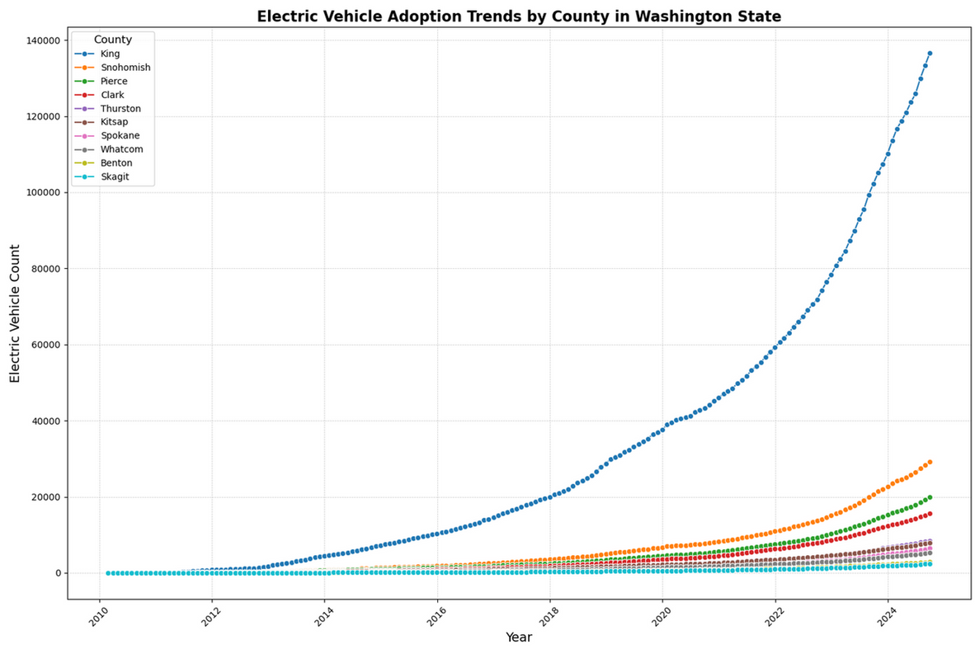
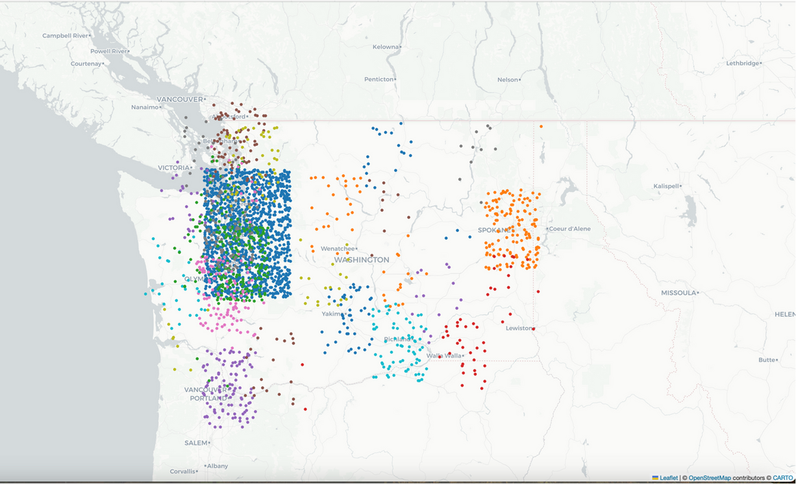
Data Exploration
King County leads in EV adoption with the highest growth rate, driven by Seattle's population and significant contribution to statewide numbers.
Other counties like Snohomish and Pierce show slower growth, highlighting the need for targeted strategies to boost regional EV adoption.
Urban areas like Seattle and King County have dense charger networks, while rural and eastern Washington need expansion to meet EV demand.
Investment opportunities exist in underserved areas and high-traffic corridors, with a focus on improving charger availability and accessibility statewide.
Notes:
Next one is also a line graph showing Electric Vehicle Adoption Trens.King County leads EV adoption in Washington, driven by Seattle's population density and robust infrastructure. However, counties like Snohomish and Pierce show slower adoption rates. This underscores the need for targeted strategies in these regions. Additionally, urban areas have dense charger networks, while rural regions require significant expansion to support EV demand.

Slide 10
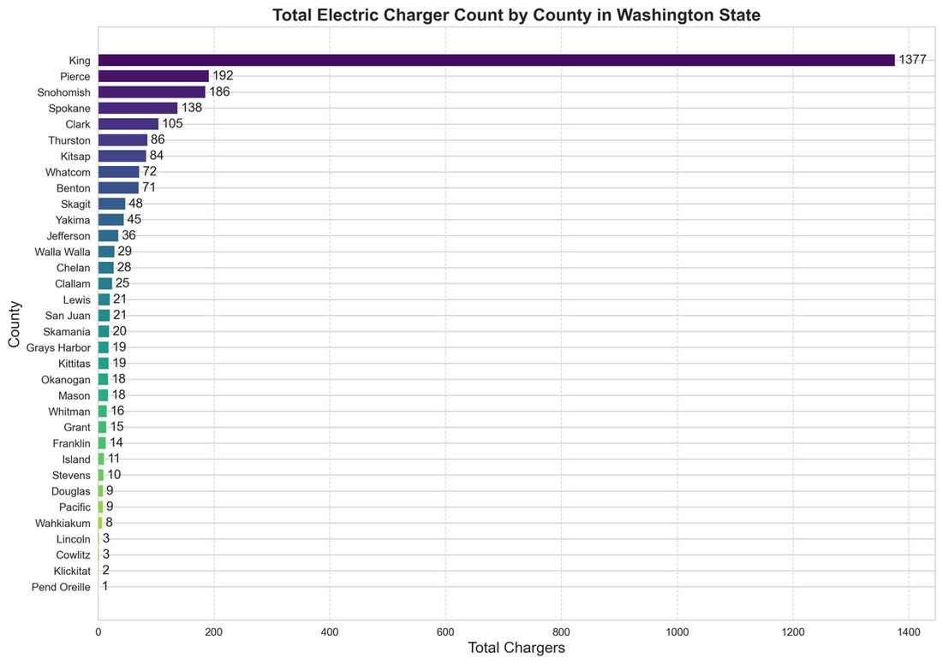
Data Exploration
King County dominates EV charger distribution in Washington State with 1,377 chargers (~50% of the total), while Pierce, Snohomish, Spokane, and Clark counties follow with significantly lower counts.
The high charger concentration in urban areas highlights the need for more balanced infrastructure investment in rural and less populated counties.
Notes:
This a bar chart showing Total Electric Charger Counts.King County holds 50% of EV chargers in Washington with 1,377 units, while Pierce, Snohomish, Spokane, and Clark lag behind. This highlights the need for balanced infrastructure expansion in rural and less populated areas.

Slide 11
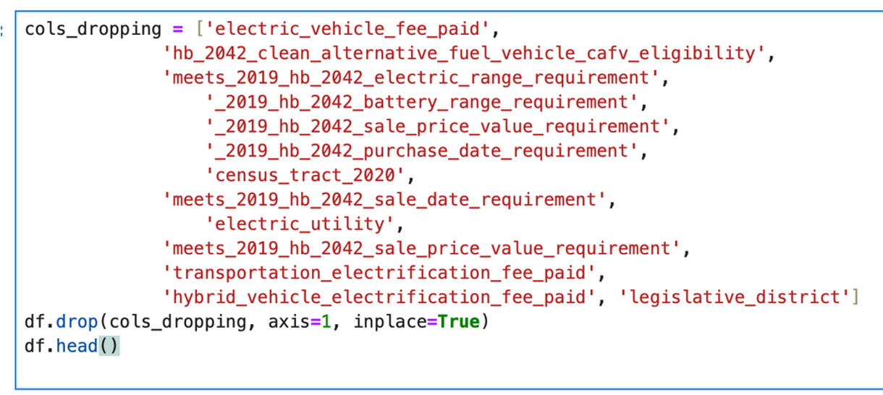
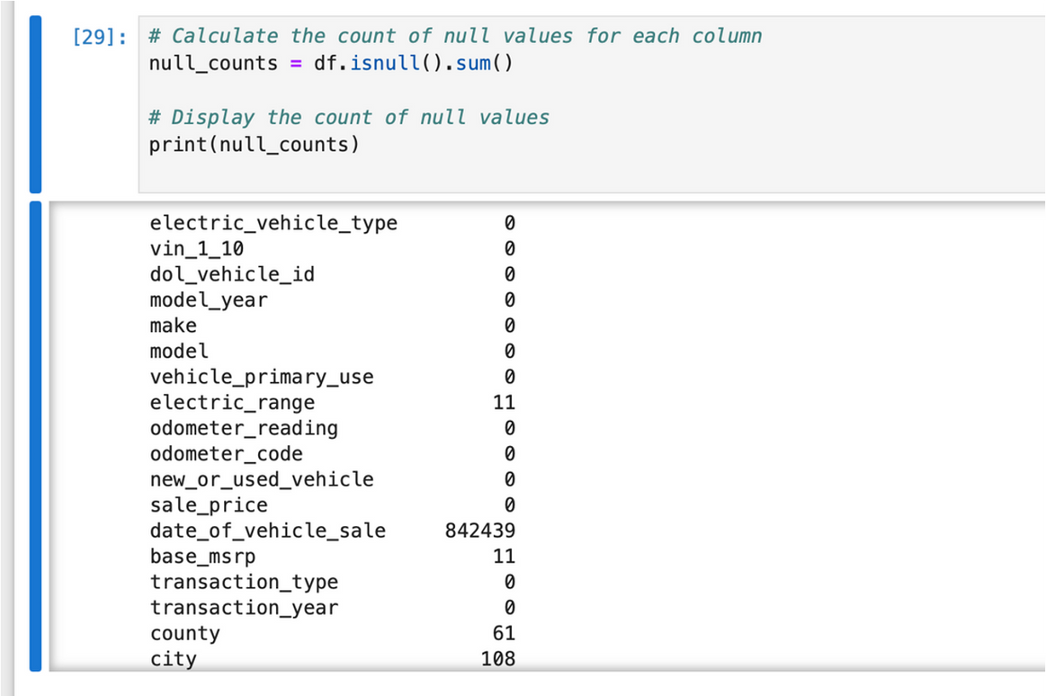
Data Preprocessing
Notes:
We removed unnecessary columns from the dataset to focus on relevant information for our analysis. Missing values were identified and handled to ensure data quality. This step helped prepare the data for accurate and efficient model development.

Slide 12
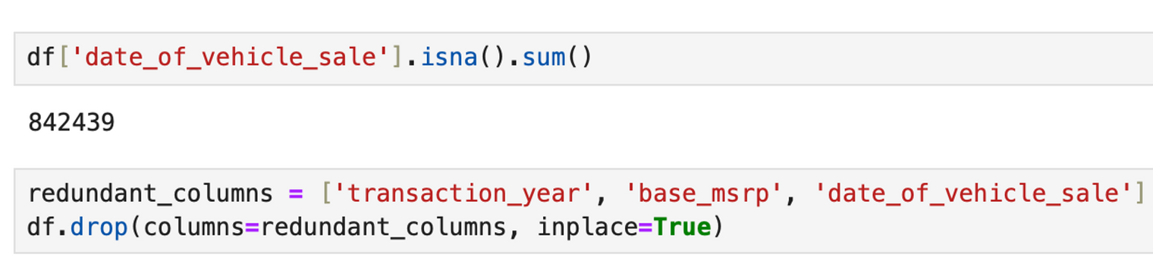
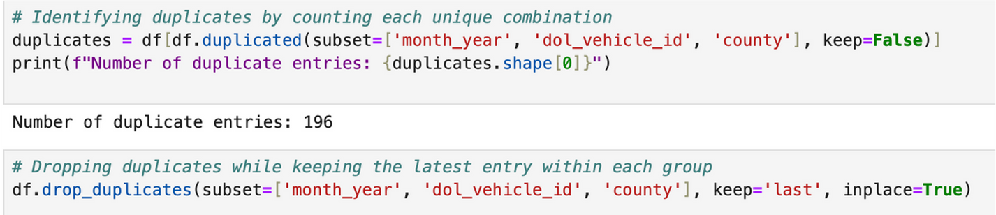
Data Preprocessing
Notes:
First, we identified and removed redundant columns like transaction_year and base_msrp to streamline the dataset. Next, we filtered rows based on transaction_type, retaining only relevant titles such as 'Original Title' and 'Transfer Title'. Lastly, we addressed duplicate entries by detecting and dropping 196 duplicates, ensuring we kept the most recent data for each unique combination of month_year, dol_vehicle_id, and county. These steps ensured a cleaner, more accurate dataset for analysis.

Slide 13
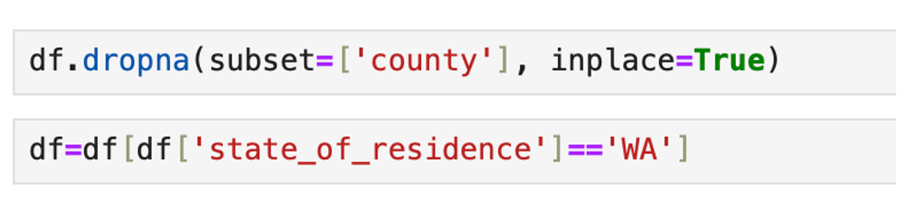
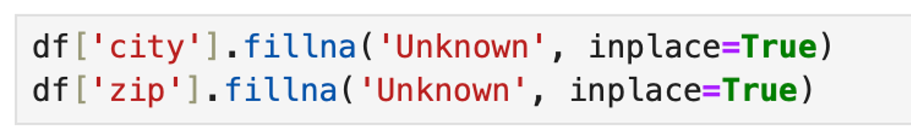
Data Preprocessing
Notes:
In this step, we addressed missing and irrelevant data to refine the dataset. We dropped rows with missing values in the county column and filtered data to include only residents from Washington state (state_of_residence = 'WA'). Additionally, we filled missing values in the city and zip columns with 'Unknown' to ensure a complete and consistent dataset for analysis.

Slide 14
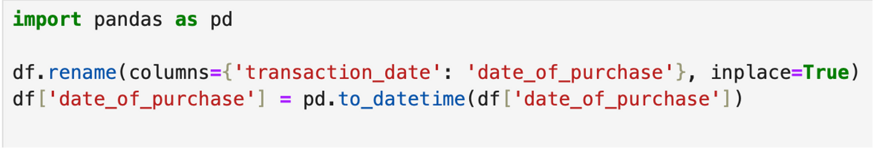
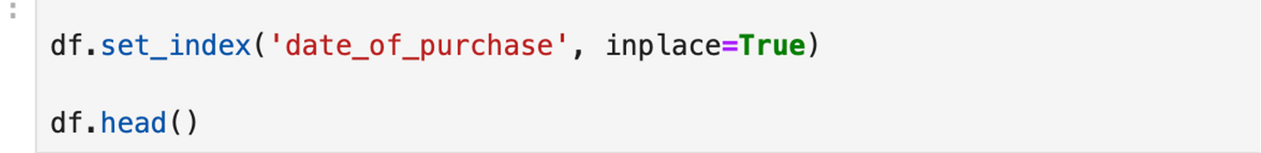
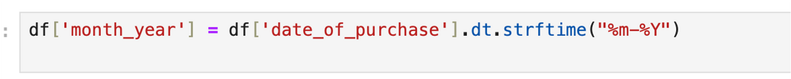
Feature Engineering
We will be using the transaction_date column for the time series we are going to be creating, we need to change its type from object to datetime.
We will be using the transaction_date column for the time series we are going to be creating, we need to change its type from object to datetime.
We will be using the m/y information to clean duplicates
Notes:
This step focuses on preparing the date column for analysis. We renamed the transaction_date column to date_of_purchase for clarity and converted its format to a standard datetime object. Then, we set the date_of_purchaseas the index for efficient time-series operations and extracted a month_year column for aggregation and trend analysis over monthly periods.

Slide 15
Machine Learning Models
ARIMA (Auto-Regressive Integrated Moving Average)
Captures trends, patterns, and correlations in non-stationary time series data.
Predicts future values based on past observations and residual errors.
Features:
Suitable for time-series with trends but no seasonal patterns.
Requires data to be stationary (trend and seasonality removed).
Captures linear dependencies effectively.
SARIMAX (Seasonal ARIMA with Exogenous Variables)
Extends ARIMA to include seasonal components and external predictors (exogenous variables).
Seasonal terms include P, D, Q, and m:
P: Seasonal autoregressive order.
D: Seasonal differencing.
Q: Seasonal moving average.
m: Number of time steps per seasonal cycle (e.g., 12 for monthly data).
Features:
Handles seasonality and external variables influencing the series.
Incorporates both long-term trends and short-term patterns.
Notes:
This slide highlights the machine learning model development process for predicting EV adoption and charger demand. We employed time-series models such as SARIMAX and Auto-ARIMA to capture seasonality and trends in EV data. These models were trained on historical data, validated with robust metrics like RMSE and MAPE, and fine-tuned for optimal accuracy to ensure reliable forecasting of future EV and infrastructure needs

Slide 16
Machine Learning Models
Handling Seasonal and Non-Seasonal Patterns:
ARIMA models non-seasonal time-series data, capturing short-term dependencies (AR, MA, I).
SARIMAX adds seasonal components, ideal for repetitive patterns like yearly EV trends.
Dealing with Complex Time Series:
SARIMAX combines seasonal (e.g., order (0,0,2,12)) and non-seasonal (1,1,2) parameters to model trends comprehensively.
Parameter Optimization:
Auto-ARIMA optimizes parameters, balancing complexity and accuracy while minimizing overfitting.
Forecast Accuracy:
SARIMAX delivers reliable forecasts validated via train-test splits and residual diagnostics.
Versatility:
These models reveal trends and seasonality in EV charger demand, aiding infrastructure planning and forecasting.
Notes:
ARIMA and SARIMAX models excel in capturing trends and seasonality in EV charger demand, enabling robust infrastructure forecasting. With parameter optimization and accurate forecasting capabilities, these models ensure effective planning by addressing both seasonal and non-seasonal patterns.

Slide 17
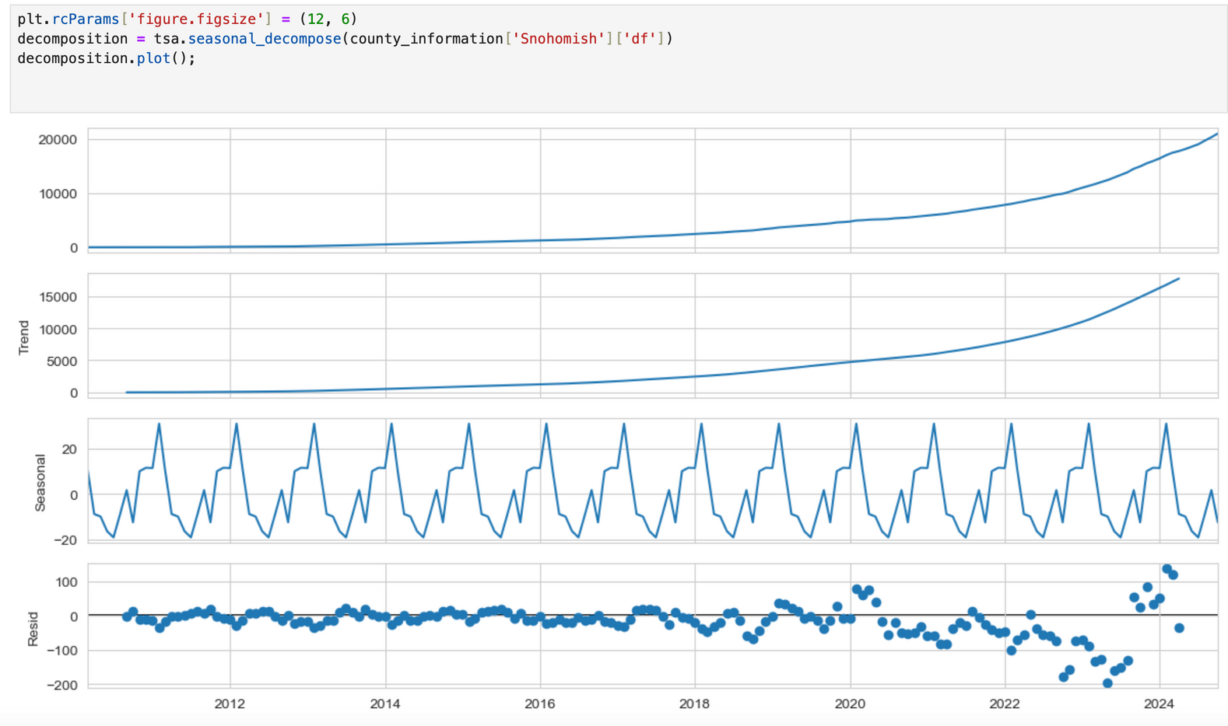
Evaluating Models for Top 10 Counties with EVs
1. Seasonal Decomposition:
Goal: Analyze seasonal, trend, and residual components of the time series.
Notes:
In this slide, we evaluate the seasonal decomposition for the top 10 counties with electric vehicles. Using seasonal decomposition, we break the time series data into three main components: the trend that captures long-term growth, the seasonality that reflects periodic patterns, and residuals which account for random fluctuations. This helps us understand the underlying patterns and informs model selection for accurate forecasting

Slide 18
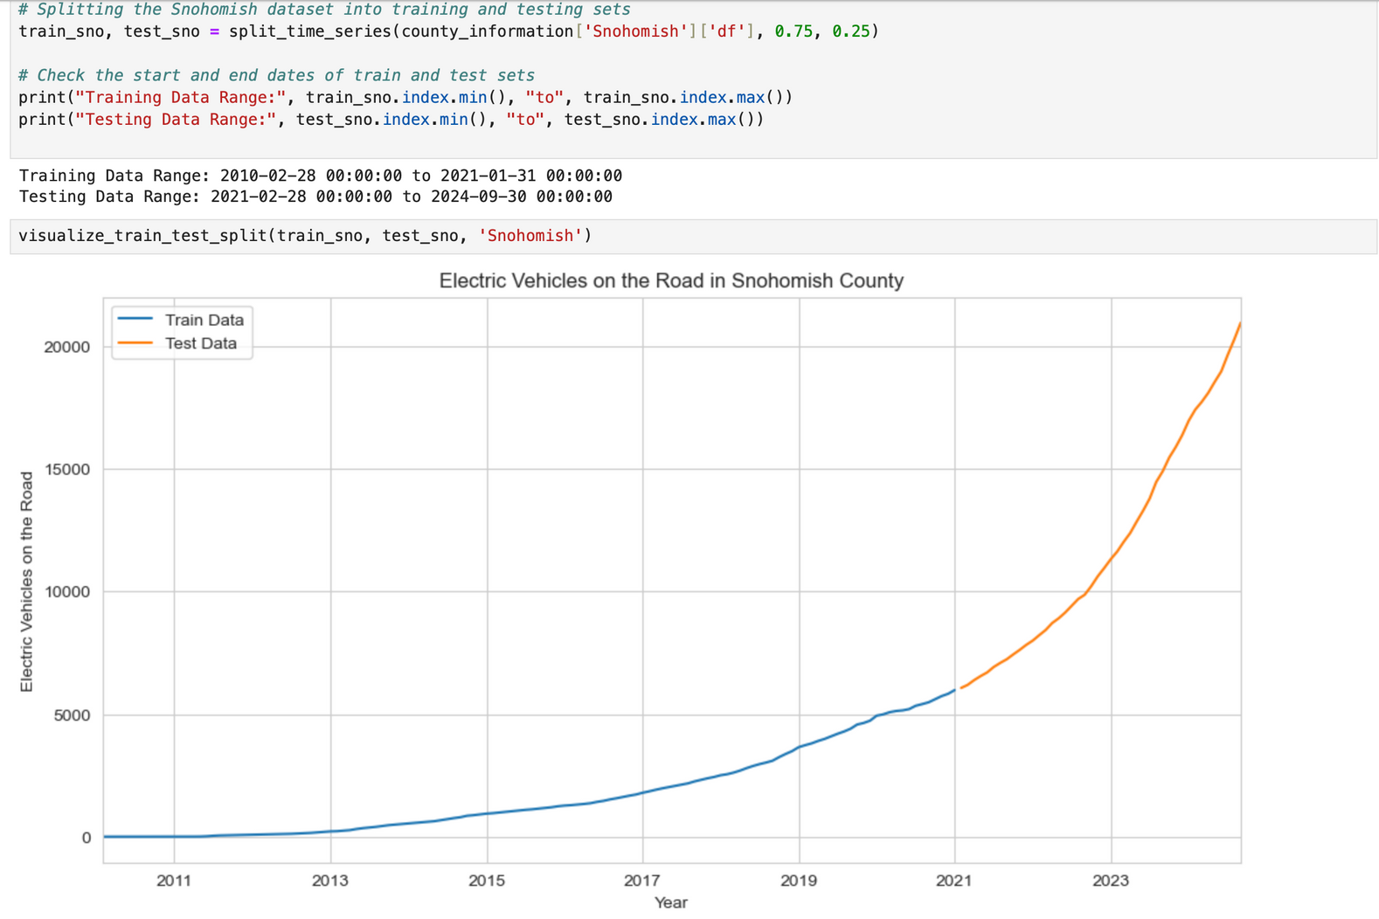
Evaluating Models for Top 10 Counties with EVs
2. Splitting Data:
Purpose: Prepare for training and testing by splitting the dataset.
Notes:
To analyze electric vehicle adoption in Snohomish County, we split the data into training and testing sets using a 75/25 ratio. The training data spans from 2010 to early 2021, while the test set covers the period up to 2024. This split ensures the model learns from past trends and is validated on unseen data for accurate forecasting of future EV adoption.

Slide 19
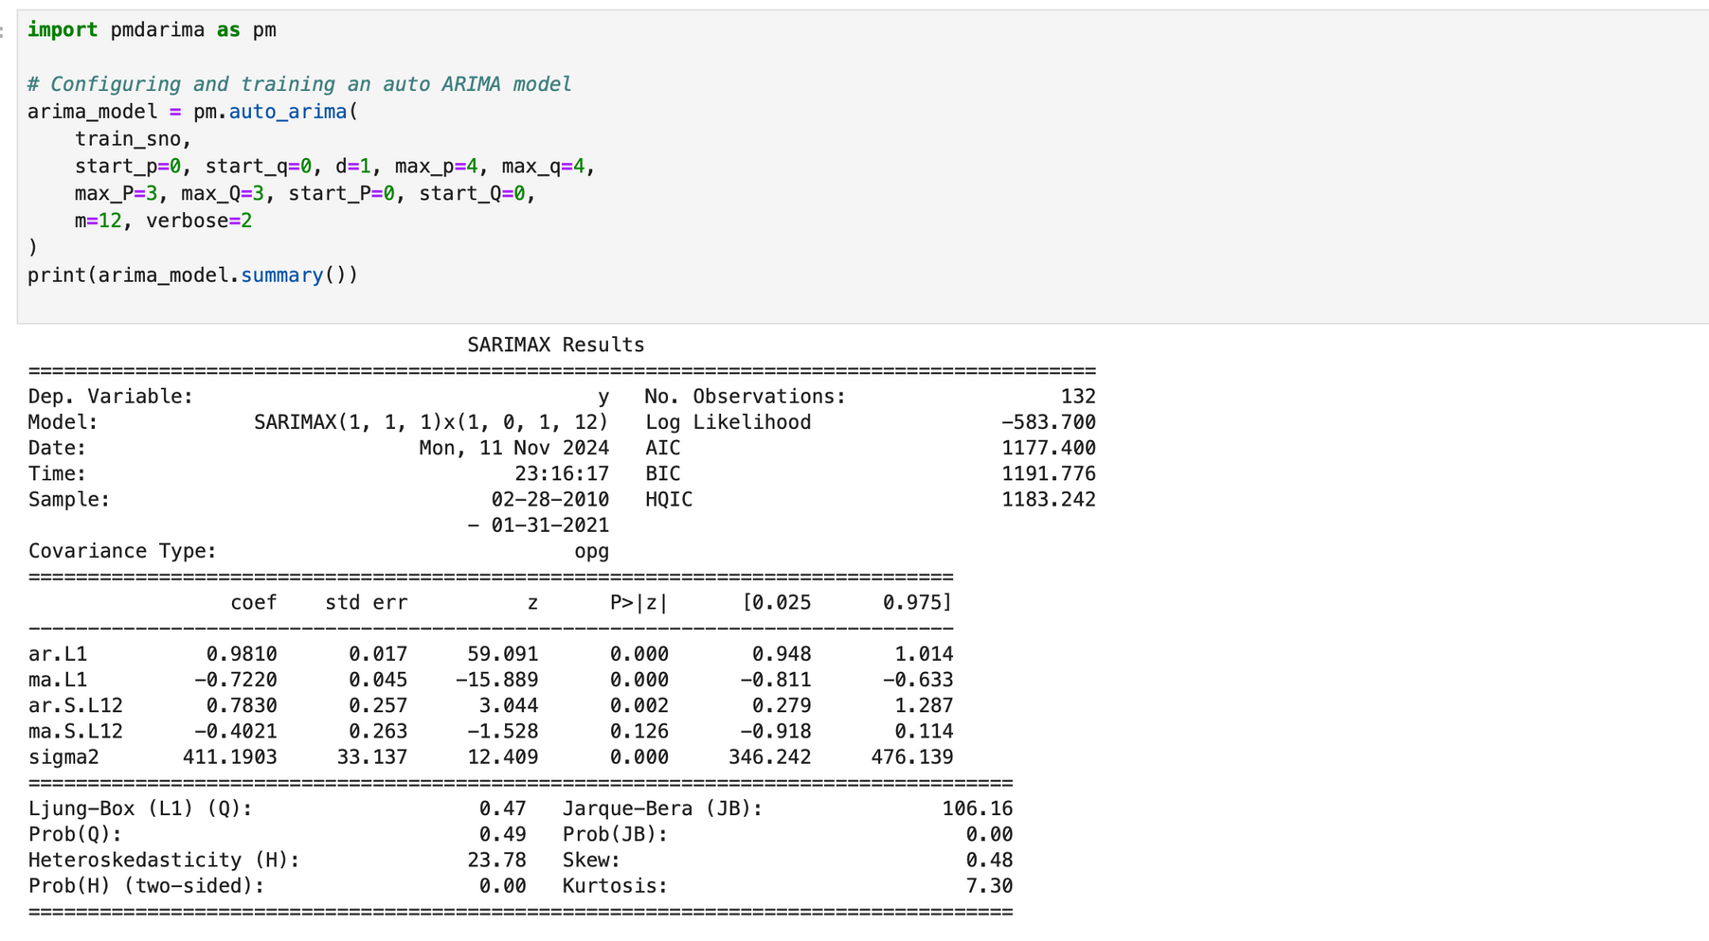
Evaluating Models for Top 10 Counties with EVs
3. Auto-ARIMA for Best Parameter Selection:
Purpose: Automatically determine optimal parameters for the ARIMA model.
Notes:
This slide demonstrates the use of Auto-ARIMA for automatically selecting optimal parameters to fit the ARIMA model. By leveraging this technique, we streamline the process of identifying the best combination of parameters, enhancing model accuracy and efficiency. This ensures reliable forecasting of electric vehicle adoption trends based on historical data, optimizing predictions for decision-making."

Slide 20
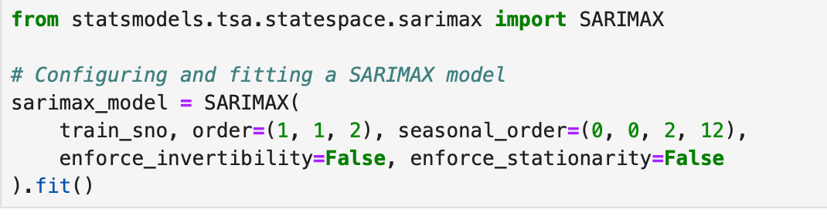
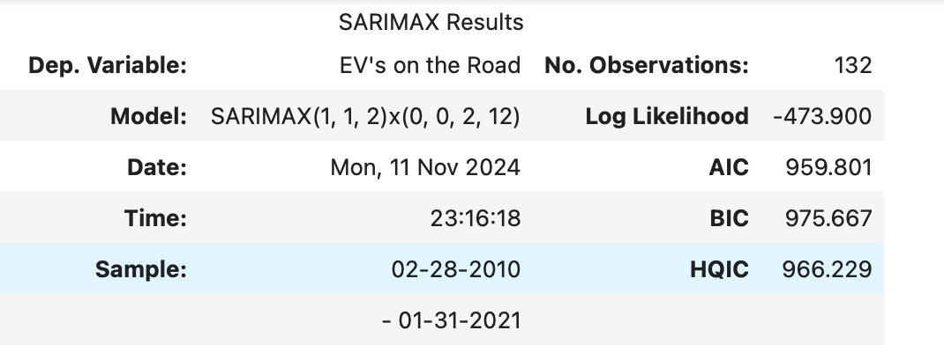
Evaluating Models for Top 10 Counties with EVs
4. SARIMAX Model Configuration:
Purpose: Fit a SARIMAX model with manually selected parameters.
Notes:
The SARIMAX model is configured to fit the data using the parameters order (1, 1, 2) and seasonal order (0, 0, 2, 12) to capture both non-seasonal and seasonal patterns. The results include key metrics like AIC, BIC, and HQIC, which help evaluate model fit and complexity. This configuration ensures the model captures trends and seasonality accurately for forecasting EV adoption and infrastructure planning.

Slide 21
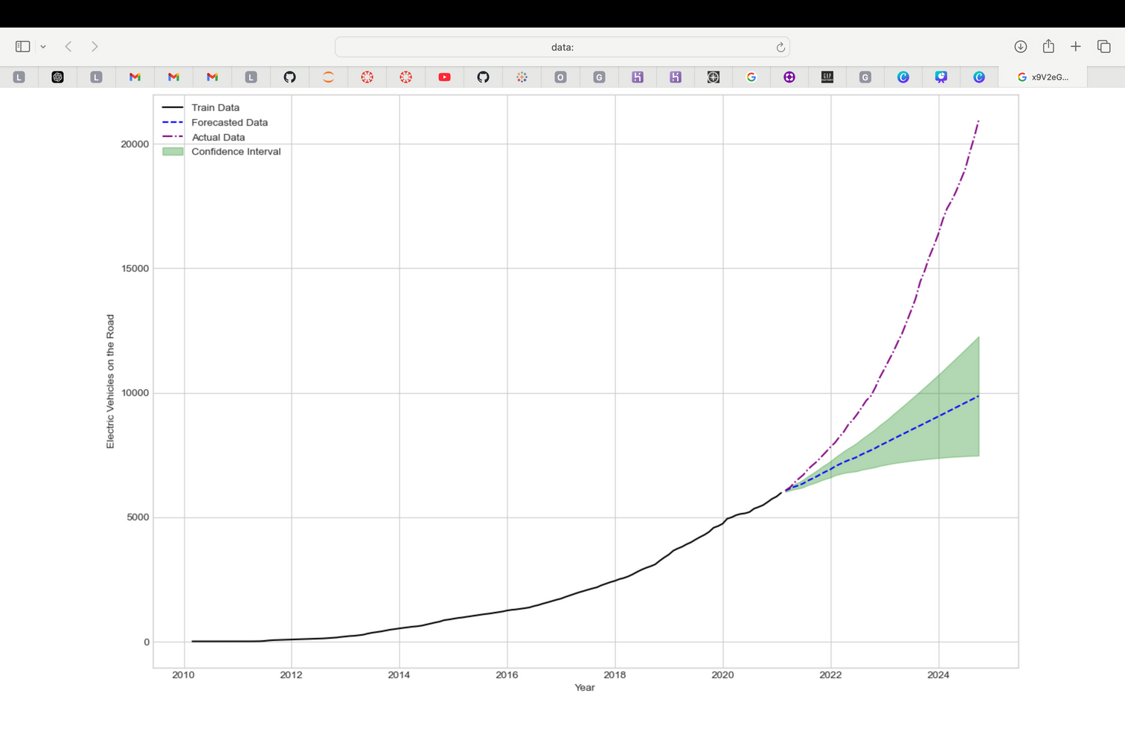
Evaluating Models for Top 10 Counties with EVs
5.Forecasting on Test Data:
Purpose: Validate the SARIMAX model by forecasting test data and comparing predictions with actual values.
Notes:
This step evaluates the SARIMAX model's predictive performance by comparing forecasted values against actual test data. The graph illustrates the training, forecasted, and actual data, along with a confidence interval to show prediction reliability. This helps validate the model's accuracy and effectiveness for EV adoption trends in Snohomish County.

Slide 22
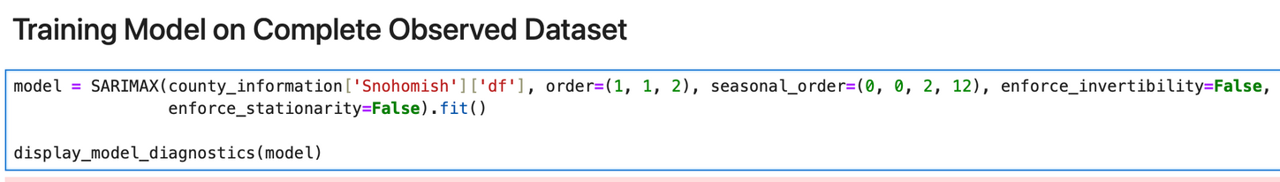
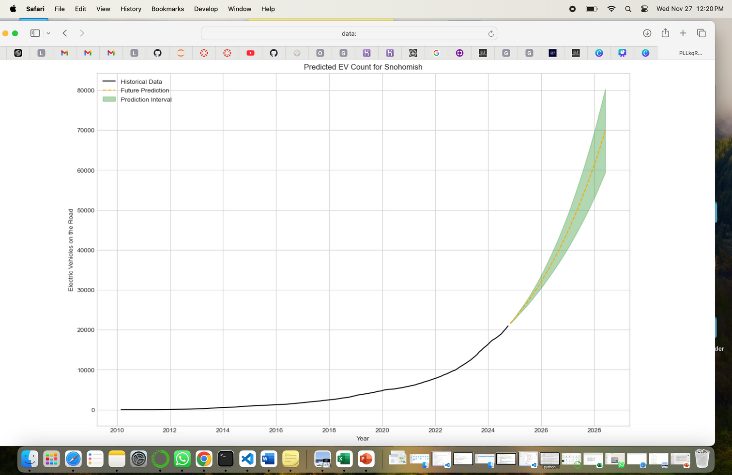
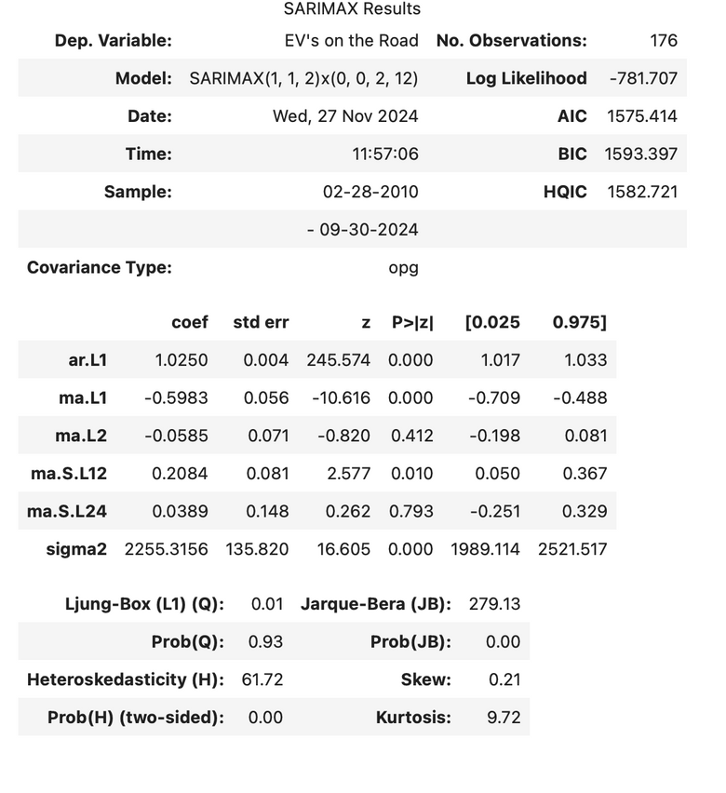
Evaluating Models for Top 10 Counties with EVs
6. Forecasting Future EV Counts for Snohomish County
Notes:
This step utilizes the SARIMAX model to predict future EV adoption trends in Snohomish County. The graph illustrates historical data, forecasted EV counts, and a prediction interval, providing insights into expected growth. These predictions help policymakers plan EV infrastructure effectively.

Slide 23
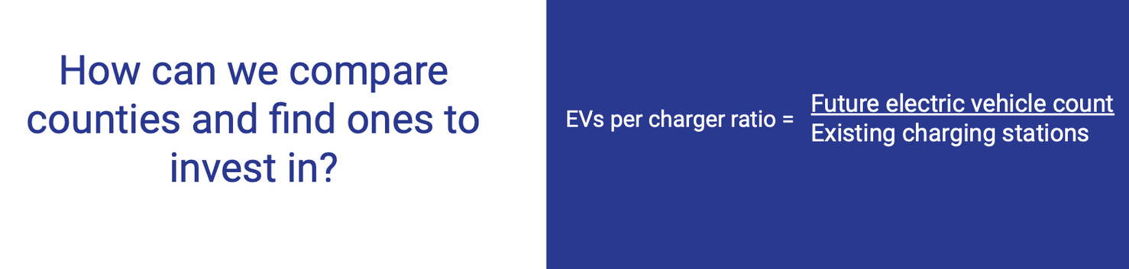
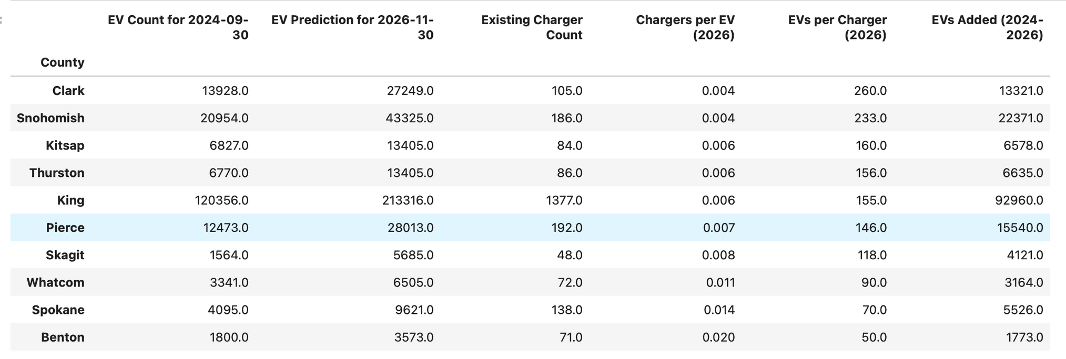
Predicted EV Demand vs Existing Charging Infrastructure
Notes:
This slide compares future EV demand to the current charging infrastructure across top counties. The EVs per charger ratio highlights areas with potential investment opportunities, where demand outpaces infrastructure capacity. For example, Snohomish County shows a high predicted EV growth with 22,371 additional EVs by 2026, but only 233 EVs per charger. Insights like these guide targeted investments to optimize infrastructure expansion effectively.

Slide 24
Let’s see some charts in Dashboard
https://public.tableau.com/shared/N9SFPQZH9?:display_count=n&:origin=viz_share_link

Slide 25
Key Insights on EV-to-Charger Ratios
High "EVs per Charger" Ratios:
Clark County: Ratio of 260 EVs per charger.
Snohomish County: Ratio of 233 EVs per charger.
Kitsap County: Ratio of 160 EVs per charger.
These high ratios indicate insufficient charging infrastructure to meet projected EV growth by 2026, necessitating urgent expansion to avoid charging bottlenecks.
Factors Influencing Optimal Charger Placement:
Proximity to Airports: Airports serve as high-traffic areas for rideshare drivers, making them ideal locations for chargers (e.g., Snohomish County).
Proximity to Highways: Major highways in transit-heavy counties like Kitsap and Clark need strategically placed chargers for long-distance drivers.
Proximity to Commercial Centers: Chargers near business districts and shopping areas (e.g., Snohomish) allow EV owners to charge while working or shopping.
Notes:
Counties like Clark (260 EVs/charger), Snohomish (233 EVs/charger), and Kitsap (160 EVs/charger) have high EV-to-charger ratios, highlighting the urgent need for infrastructure expansion to meet the projected EV growth by 2026 and prevent charging bottlenecks. Optimal charger placement should focus on high-traffic areas such as airports (e.g., Snohomish County) for rideshare drivers, highways in transit-heavy regions like Kitsap and Clark for long-distance travelers, and commercial centers (e.g., Snohomish) to support EV owners charging while working or shopping.

Slide 26
County Recommendations for EV Charging Infrastructure Investment
1. Clark County:
EVs per Charger Ratio: Highest ratio, indicating strong demand.
Key Locations: Commercial centers, near Portland International Airport (PDX).
Recommendation: Install chargers in business districts to support commuters and visitors.
2. Snohomish County:
EVs per Charger Ratio: High demand due to growing EV adoption.
Key Locations: Highway 2, business districts, Paine Field Airport.
Recommendation: Expand infrastructure near transit routes and commercial hubs.
3. Kitsap County:
EVs per Charger Ratio: High ratio due to ferry-driven commuter demand.
Key Locations: Ferry terminals and suburban centers.
Recommendation: Focus on chargers near ferry routes to serve commuters and visitors.
4. Thurston County:
EVs per Charger Ratio: High ratio, with demand from government and highway activity.
Key Locations: Interstate 5, government offices, commercial areas.
Recommendation: Prioritize chargers along Interstate 5 and in urban hubs.
Notes:
Clark County has the highest EVs per charger ratio, highlighting significant demand for additional infrastructure. Key locations include commercial hubs and areas near Portland International Airport, where chargers can support commuters and visitors effectively. Similarly, Snohomish County experiences high EV adoption, necessitating expansion near Highway 2, business districts, and Paine Field Airport. In Kitsap County, ferry-driven commuter demand underscores the need for chargers at ferry terminals and suburban centers. Thurston County, with its government and highway-related activities, would benefit from strategically placed chargers along Interstate 5 and within urban hubs to meet growing needs efficiently.

Slide 27
Conclusion
Key Takeaways:
Exponential EV Growth: Rapid EV adoption in Washington State due to environmental awareness and policies.
Popular EV Models: Tesla Model Y and X dominate, requiring chargers for high-end EVs.
Strategic Factors for Infrastructure Planning:
Commercial Hubs: Supports urban/suburban users.
Highways: Key for long-distance travel.
Airports/Ferry Terminals: High commuter and rideshare traffic.
Recommendations:
Expand chargers in underserved areas with high EV-to-charger ratios.
Incorporate faster charging technologies for future compatibility.
Partner with businesses for funding and placement.
Conduct detailed city-level studies for precise strategies.
Outcome:
Invest strategically to position Washington State as a leader in transportation electrification.
Notes:
Washington State is experiencing rapid EV adoption, driven by environmental policies and demand for high-end models like Tesla Model Y and X. Key infrastructure needs include chargers near commercial hubs, highways, and high-traffic areas like airports and ferry terminals. To address high EV-to-charger ratios, expanding charging networks in underserved areas, adopting faster charging technologies, and collaborating with businesses for funding are essential. Detailed city-level studies will refine strategies, ensuring Washington leads in transportation electrification.
4o

Slide 28

Thank you

